Slide 1
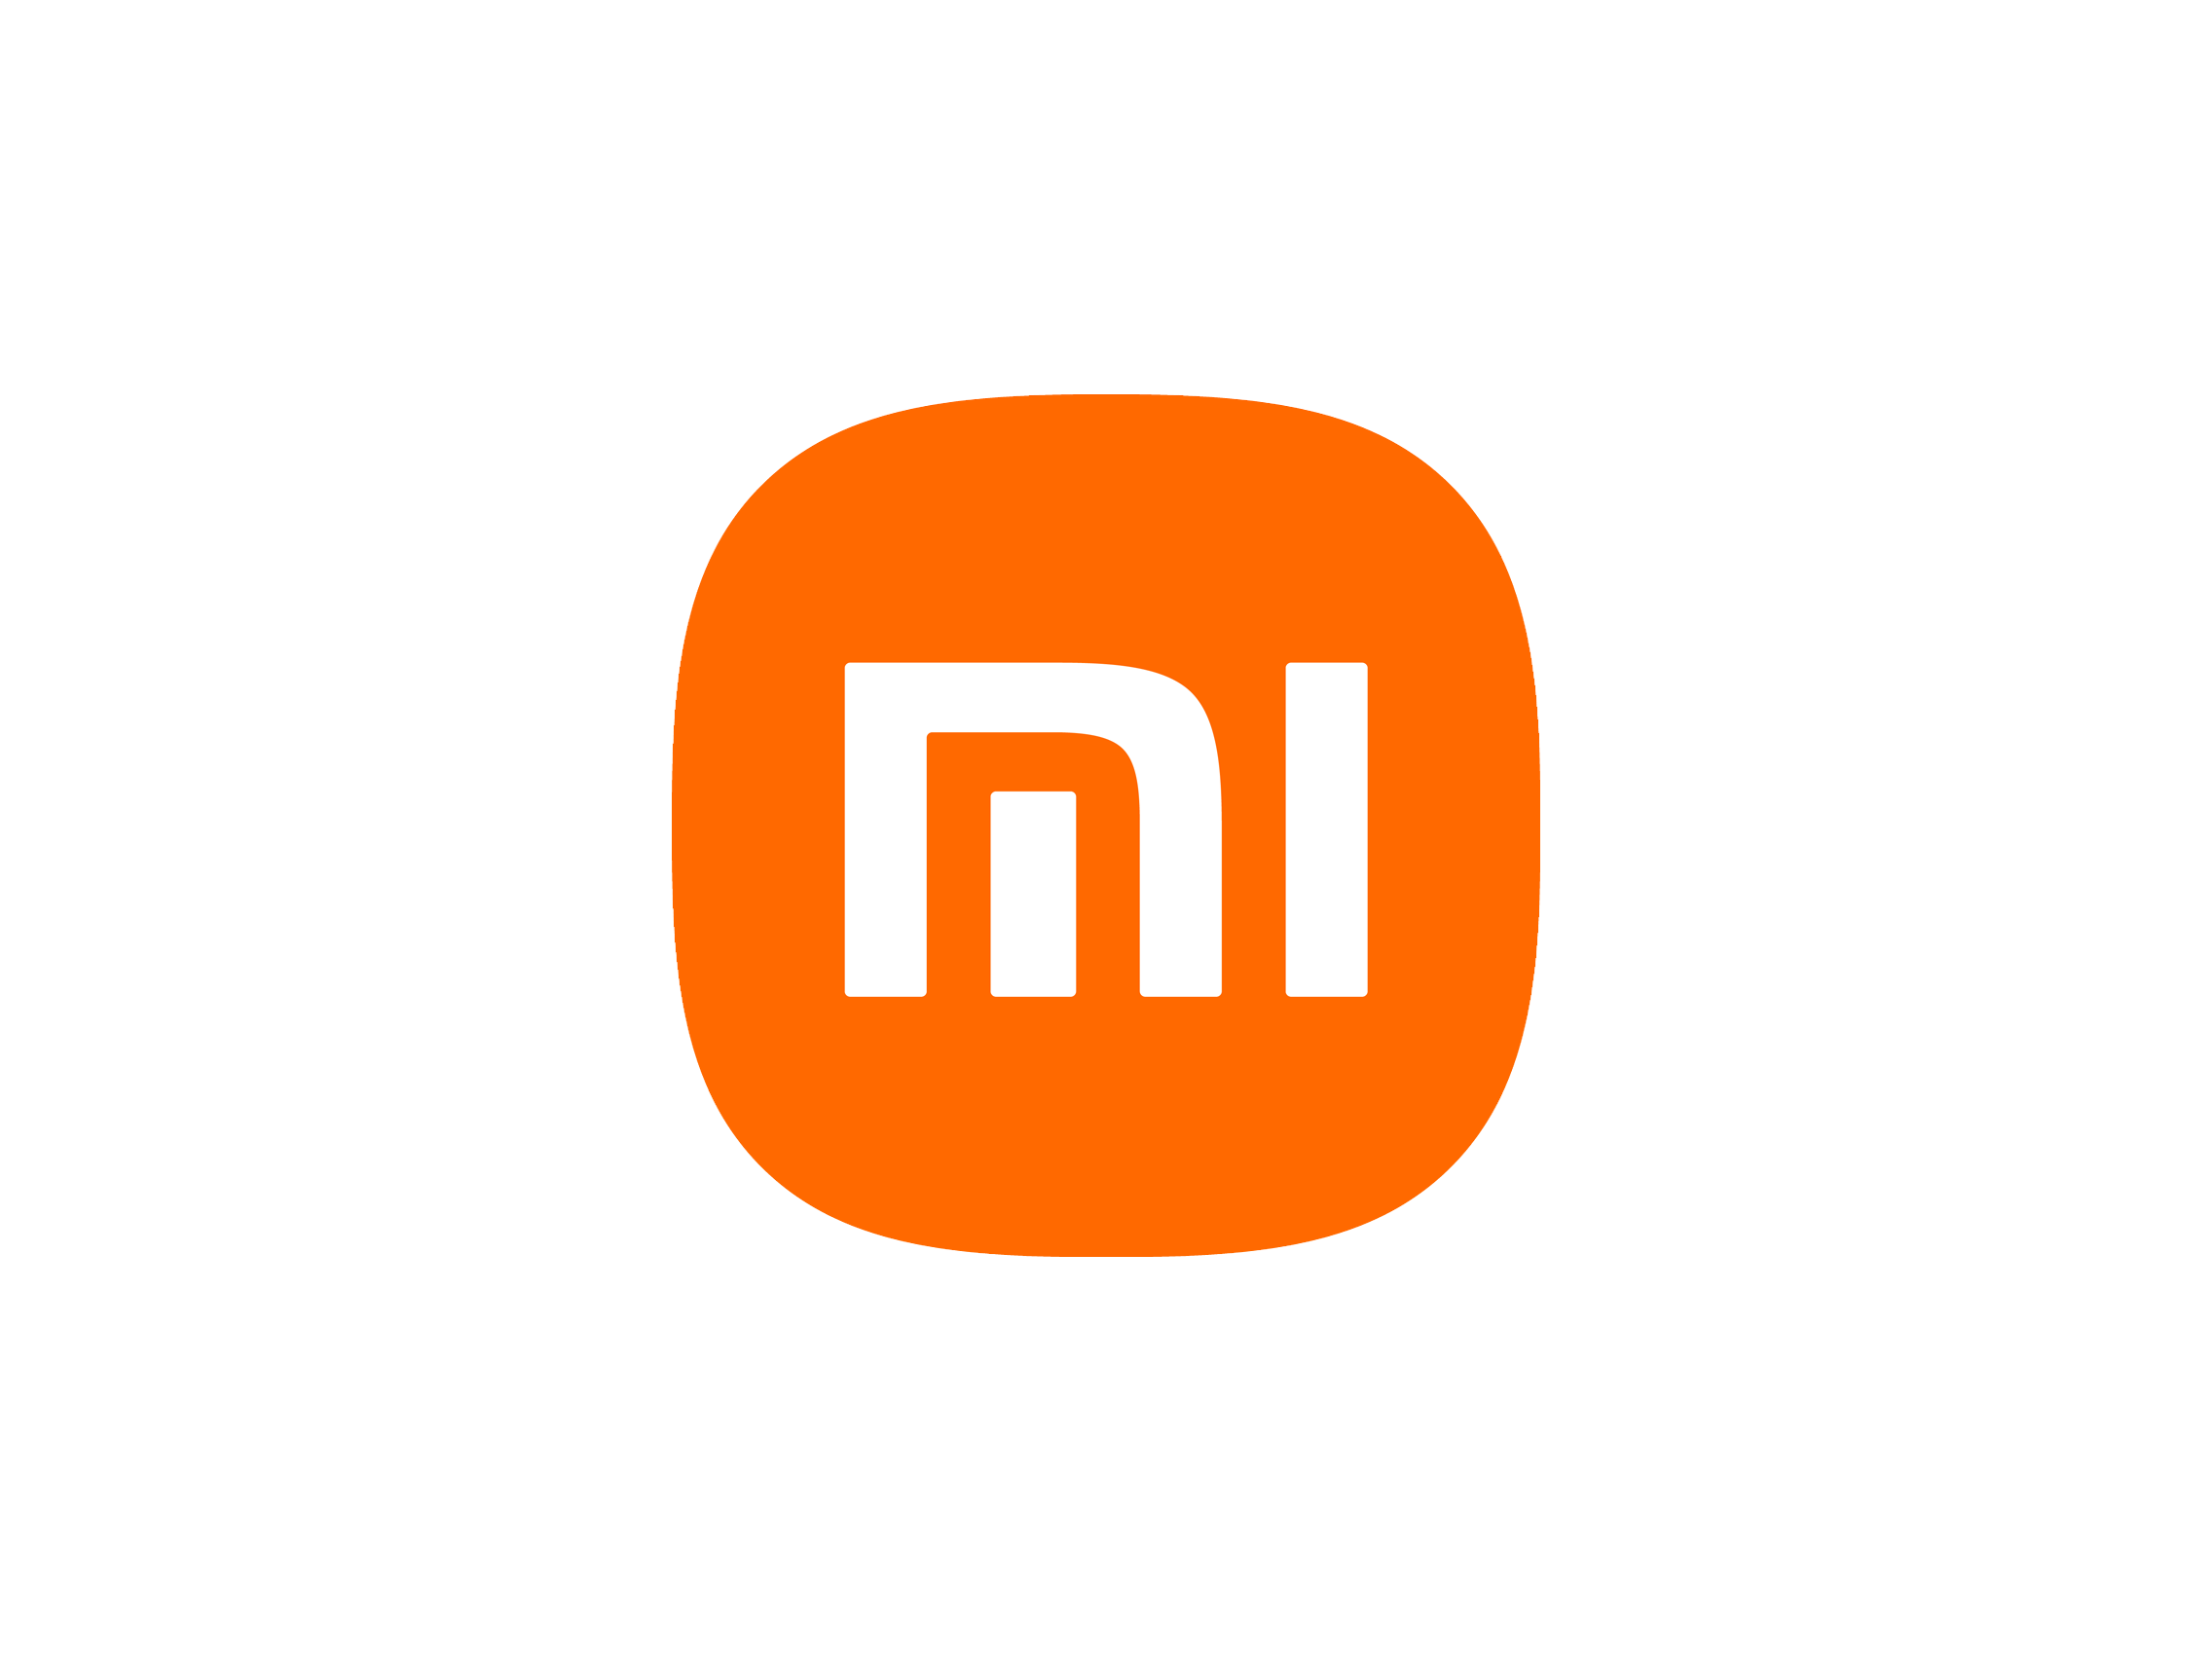
History of
Xiaomi Corporation

Slide 2
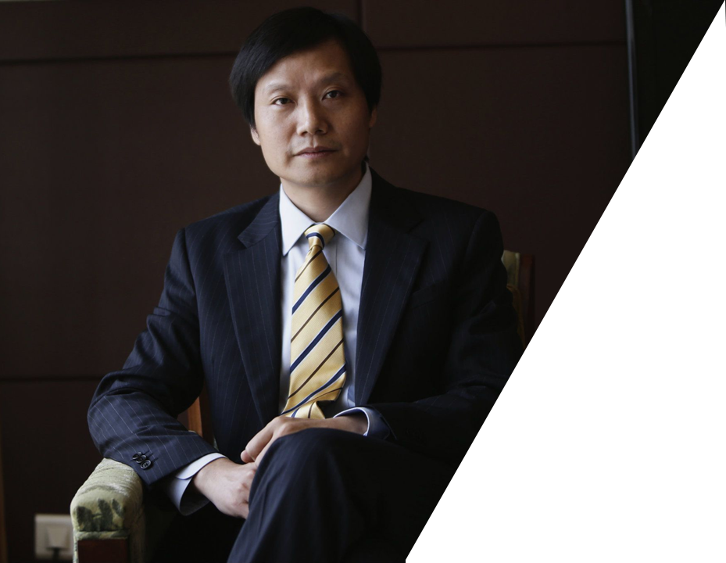
1
Xiaomi was founded in April 2010 as a company engaged in creating custom firmware for Android-based devices by former Kingsoft CEO Lei Jun.
Their goal was to provide additional functionality beyond what Android could offer and simplify the user interface. The firmware, which was named MIUI, was a huge success and was ported to many devices. By 2014, MIUI had been downloaded and installed on more than 200 device models in English and Chinese.
2
3
Even without being a developer, the user can easily install MIUI on his smartphone using MIUI Express APK. At the end of 2013, there were over 30 million MIUI users worldwide. Very impressive for such a young company at that time.

Slide 3

1
Official website of the company mi.com informs that there is no canonical interpretation of the first two letters in the name. MI can be defined as a simple combination of "Mobile Internet" or the more ambitious "Mission Impossible" - as a designation of the difficulties that Xiaomi has challenged. But there are many other interpretations. There is no intrigue in the second half of the UI name — it is the User Interface.
2
Only three people worked on the first versions of the MIUI system. It was developed based on Android 2.2 Froyo. Since Xiaomi did not have its own smartphones yet, their system was installed on third-party devices — the first was Google Nexus One.

Slide 4
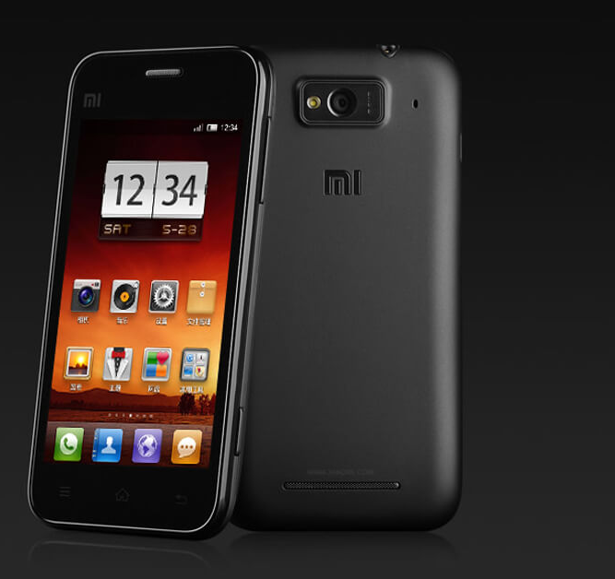
1
On the 16th of August, 2011, Xiaomi organized a small event, the so-called meetup for fans, but there were also journalists there. It's hard to tell from the photos how many people came, but there were a lot of them.
At the presentation, the company announced the first smartphone Xiaomi Phone (Mi1 or Mi-One). The director of the company emphasized that their smartphone is equipped with a large 1930 mAh battery and will actually work for two days on a single charge.
2

Slide 5
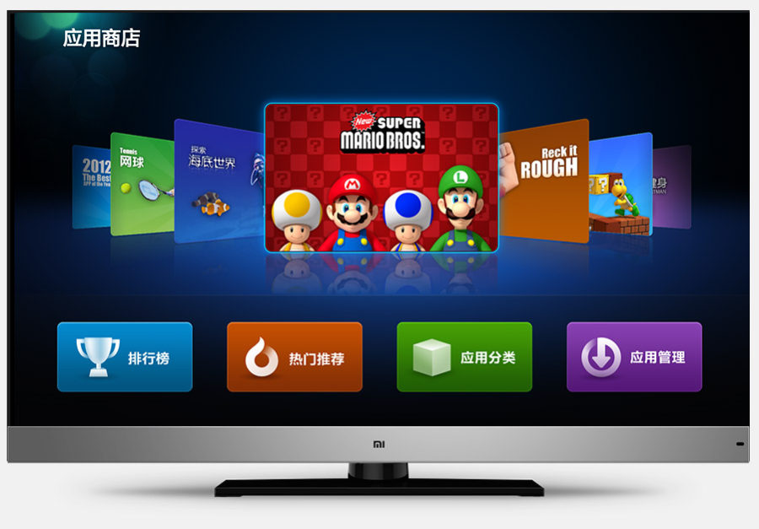
The next stage for the company was the announcement of the TV on the 5th of September, 2013, which received a 47-inch display with 3D and an Android-based SmartTV system. Another important event is the accession of Hugo Barr to Xiaomi as vice president. In the past, he worked at Google on Android and was the face of the system at all conferences.
Also in September, the new flagship Xiaomi Mi3 was introduced, which allowed the company to increase sales even more. As a result, in 2013 they sold 18.7 million devices, but this is only the beginning of rapid growth.

Slide 6

1
In 2014, Xiaomi began selling routers, set-top boxes, air purifiers, portable batteries and other small appliances and accessories, at the same time it expands the line of smartphones to an unimaginable number, releases MIUI 6 and announces the Mi Pad tablet.
The Mi Band fitness bracelet has become a real bestseller. The company managed to release the most "smart" gadget with a strikingly low price and capture the emerging wearable electronics market, second only to the established leader Fitbit.
2
3
Xiaomi ranked fifth among global smartphone manufacturers in Q4 2014 with a market share of 4.42% and became the absolute leader in shipments in China. At the same time, Xiaomi met its ambitious goal of selling 60 million smartphones in 2014. The company achieved these results in less than four years of operation.

Slide 7
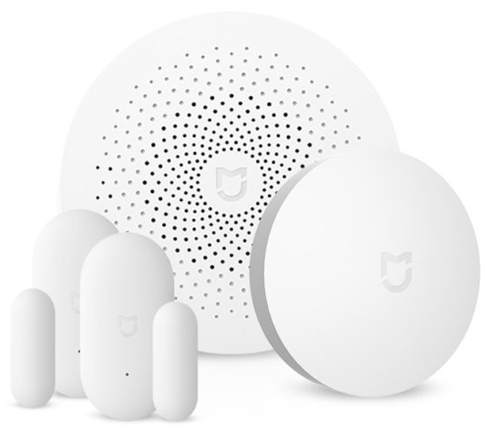
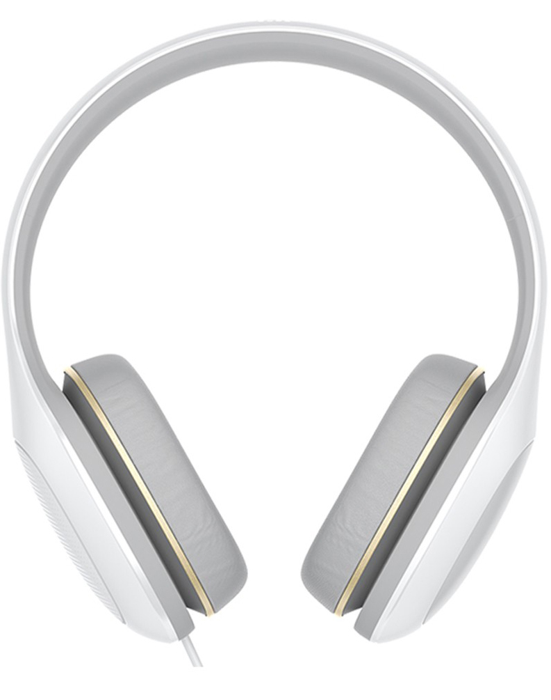
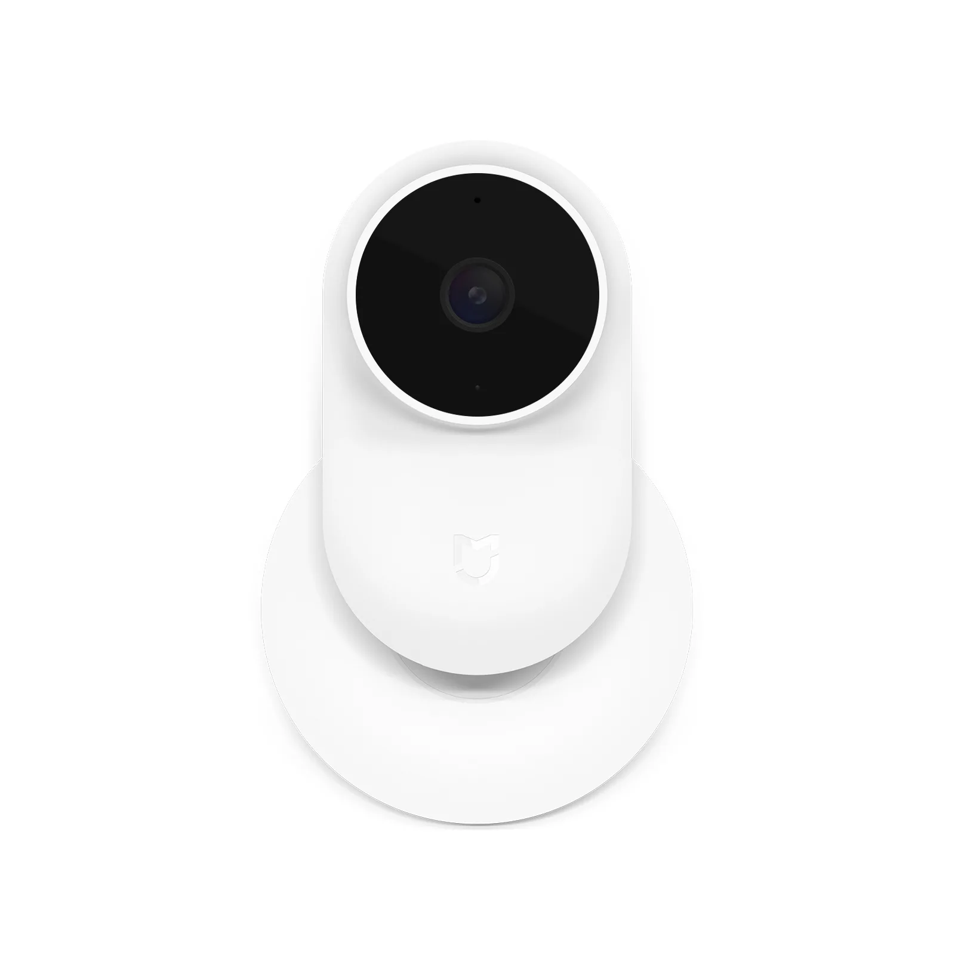
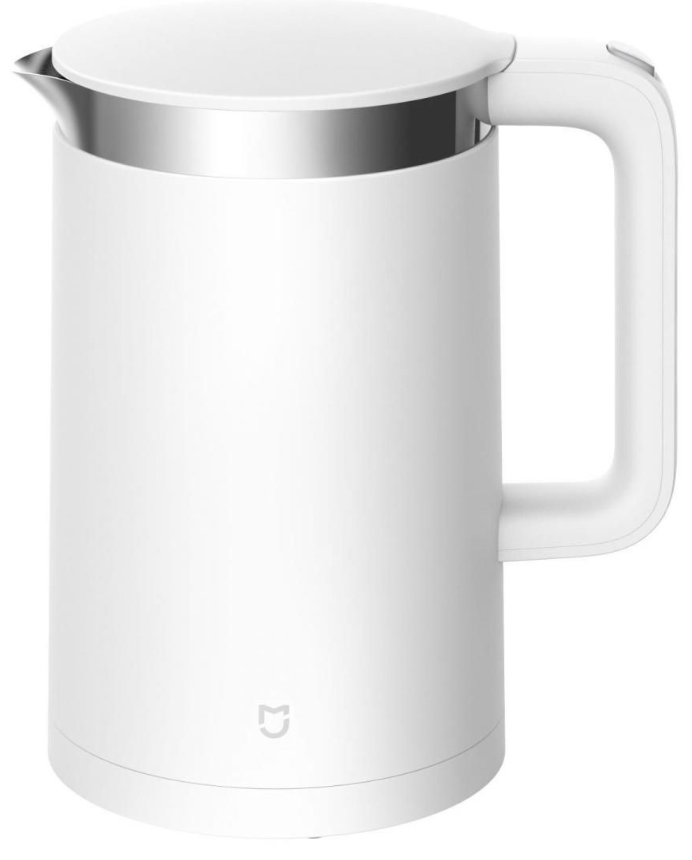
The company now
1
Xiaomi's line of devices and accessories is impossible to count. It would seem that the company has released all sorts of gadgets: headphones, scales, humidifiers, kettles, bags, backpacks and suitcases, security cameras, a huge line of "smart" home devices with motion sensors, temperature sensors, and so on, and so can be listed to infinity. Xiaomi also has many subsidiaries that produce "smart" speakers and various electric screwdrivers.
“Smart" Home
Headphones
2
Since 2011, it has released almost 50 smartphones, three tablets, and several laptops. And it is definitely not going to stop. According to the results of the third quarter of 2017, the company returned to the top five among global manufacturers with a market share of 7.4% - a year-on-year increase of 102%. This is a very good result.
Kettles
Security Camera

Slide 8
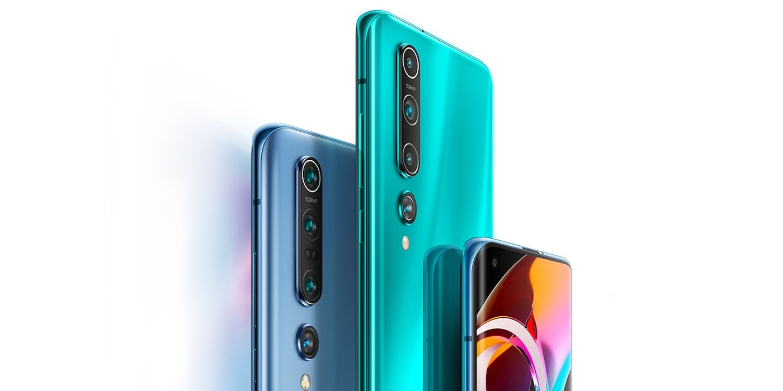
Ф
Good luck

